Slide 1
Mobile CX
Carolyn Grant I 6peas marketing & engagement I 0437822142 I Carolyn@6peas.com.au

Slide 2
Why mobile?
Everyone is using it.
Carolyn Grant I 6peas marketing & engagement I 0437822142 I Carolyn@6peas.com.au

Slide 3
Your story
What is a bad experience?
Carolyn Grant I 6peas marketing & engagement I 0437822142 I Carolyn@6peas.com.au

Slide 4
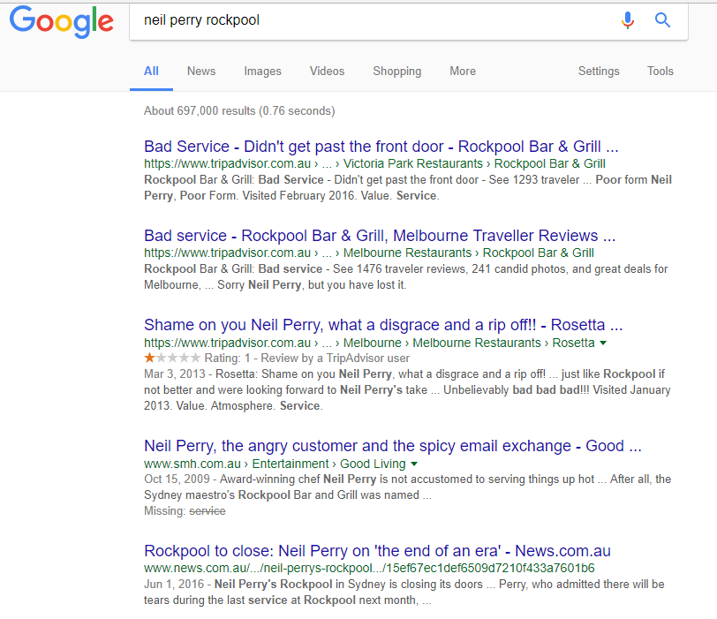
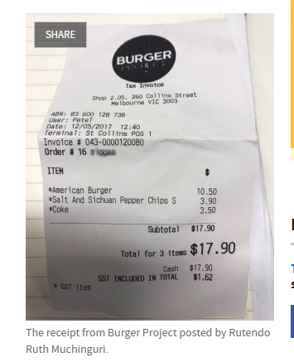
Powerless to stop
Carolyn Grant I 6peas marketing & engagement I 0437822142 I Carolyn@6peas.com.au

Slide 5
insights
Achievement
Effort
Emotion
Experience
Carolyn Grant I 6peas marketing & engagement I 0437822142 I Carolyn@6peas.com.au

Slide 6
insights
EMOTION
S - Significance
C – Certainty
A – Autonomy
R – Relationship
E – Equity/fair
Carolyn Grant I 6peas marketing & engagement I 0437822142 I Carolyn@6peas.com.au

Slide 7
emotion
Carolyn Grant I 6peas marketing & engagement I 0437822142 I Carolyn@6peas.com.au

Slide 8
Humanise
digital
human
to digital
goals
feedback
polite
personalise
empathy
purpose
responsive
continuous improvement
Carolyn Grant I 6peas marketing & engagement I 0437822142 I Carolyn@6peas.com.au

Slide 9
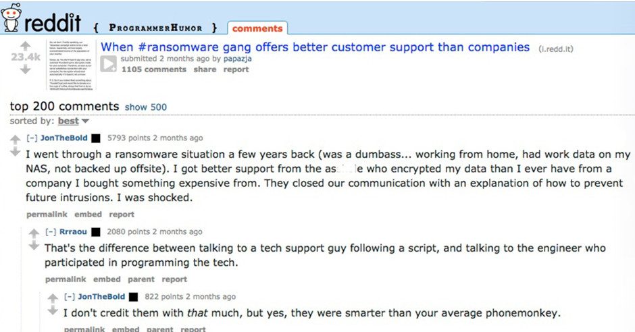
example
Carolyn Grant I 6peas marketing & engagement I 0437822142 I Carolyn@6peas.com.au

Slide 10
Humanise
digital
Chatbooks
Carolyn Grant I 6peas marketing & engagement I 0437822142 I Carolyn@6peas.com.au

Slide 11
actions
condensed
contextual
conversational
current
comprehensive
Carolyn Grant I 6peas marketing & engagement I 0437822142 I Carolyn@6peas.com.au

Slide 12
thanks
thoughts?
questions?
Carolyn Grant I 6peas marketing & engagement I 0437822142 I Carolyn@6peas.com.au

